Slide 1
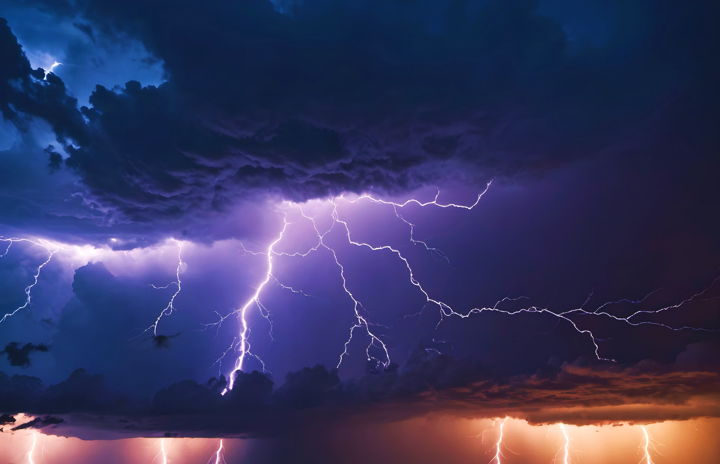

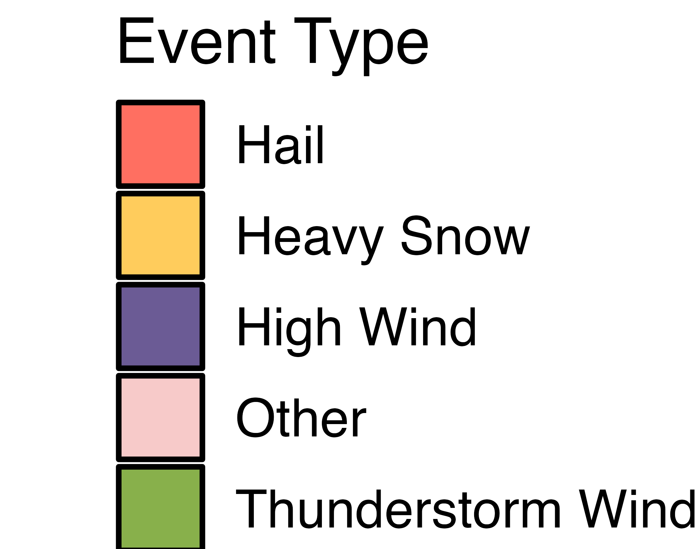

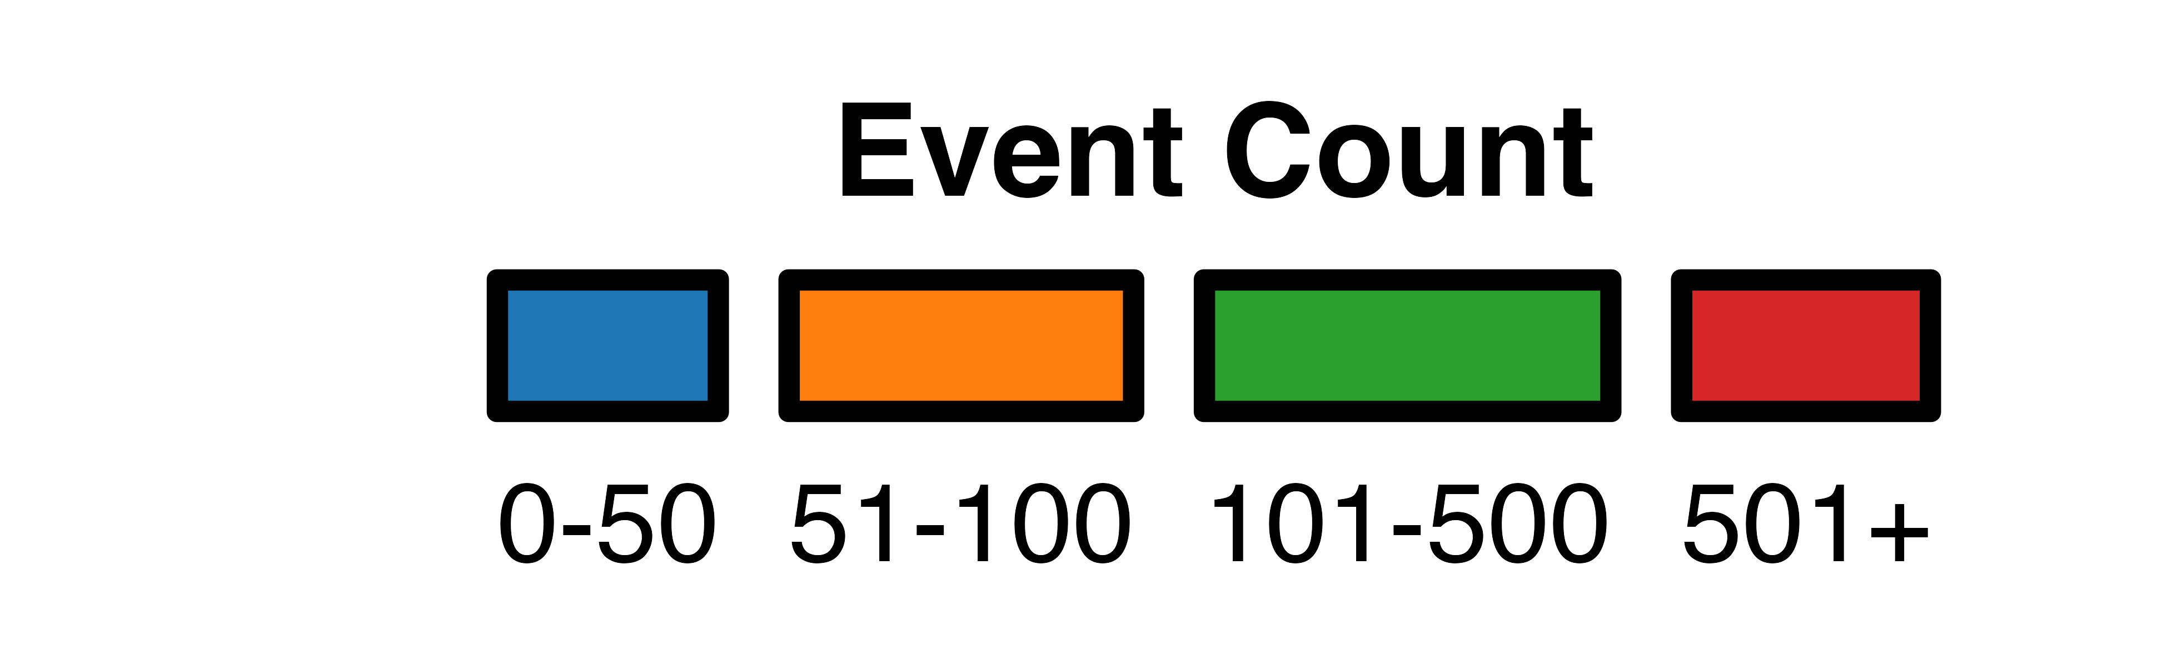

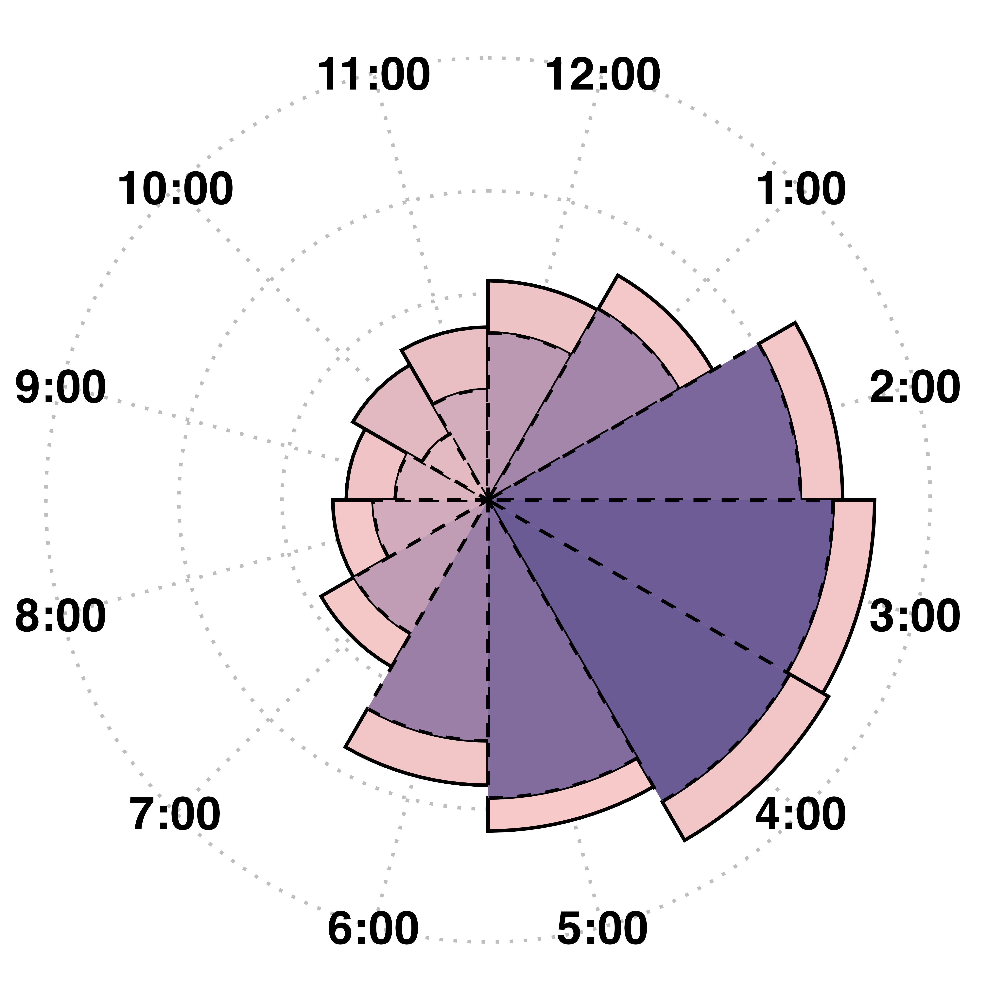


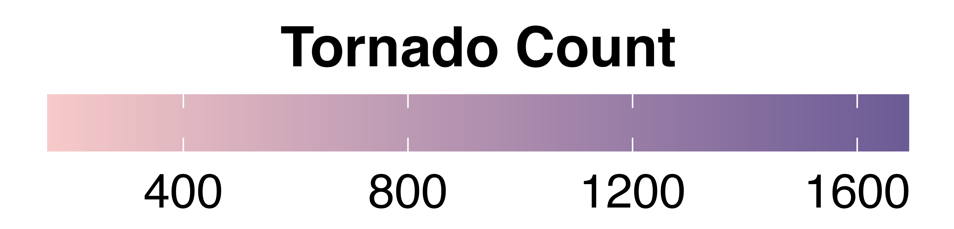
StormWatch:
Created by: Reyhaneh Bolouri
Md Tahidul Islam
Sai Varsha Sreeperumbudur
Analyzing Trends and Predicting the Future of Extreme Weather in the United States
Background
Over The Past Decade, Harsh Storm Events Have Ravaged Midwest and East Coast In The United States
Over the past decade, data from the National Weather Service (NWS) and NOAA reveals a dramatic increase in severe weather events across the United States. This visualization highlights the staggering frequency and intensity of storms, especially in Texas, which tops the charts year-round. Utilizing ARIMA models, our analysis predicts an alarming surge in storm events from 2023 onwards. Geospatial maps illustrate that Texas counties often face over 500 storm events, with 2017 alone causing $30 billion in damages. Notably, late afternoons and evenings are peak times for storm occurrences, underscoring the urgent need for enhanced preparedness and resilience measures.
Brace for More Storms in USA!
​Our analysis shows a dramatic surge in frequency and intensity starting from 2023, urging immediate action for future resilience.​
Texas tops the charts for highest storm events in USA All Year!
Spring | Summer | Fall | Winter
Texas | Texas | Texas | Texas
Kansas | California | Kansas | Kansas
California | Kentucky | Iowa | Oklahoma
Georgia | New York | S. Dakota | Missouri
Oklahoma | Virginia | Nebraska | Iowa
Texas leads the nation in severe weather events and costly disasters, accounting for 15% of all U.S. billion-dollar disasters. This county-level map illustrates the state's vulnerability, with most counties experiencing up to 500 storm events, and some even surpassing 500
In 2017: Storms Unleashed $30 Billion Havoc
Enough to Build 150 Hospitals or Fund 3M Scholarships for Students
Tornadoclock!
Scan the QR code or follow the link to explore our Interactive Texas Storm Map!
Late Afternoon and Evening Hours Show Highest Counts! (500 Events per Polar Axis)
Heads up, Texas!
Our ARIMA forecast shows a spike in storm events coming in near future.
https://tahidul94.shinyapps.io/myapp123/
Dash = AM, Bar = PM

Slide 2
Exploring Storm Events in the United States:
Created by: Reyhaneh Bolouri
Md Tahidul Islam
Sai Varsha Sreeperumbudur
An In-depth Look at Spatial and Temporal Trends of Storm Events and Their Impacts
Background
Over The Past Decade, Harsh Storm Events Have Ravaged Midwest and East Coast In The United States
Over the past decade, data from the National Weather Service (NWS) and NOAA reveals a dramatic increase in severe weather events across the United States. This visualization highlights the staggering frequency and intensity of storms, especially in Texas, which tops the charts year-round. Utilizing ARIMA models, our analysis predicts an alarming surge in storm events from 2023 onwards. Geospatial maps illustrate that Texas counties often face over 500 storm events, with 2017 alone causing $30 billion in damages. Notably, late afternoons and evenings are peak times for storm occurrences, underscoring the urgent need for enhanced preparedness and resilience measures.
Brace for More Storms in USA!
​Our analysis shows a dramatic surge in frequency and intensity starting from 2023, urging immediate action for future resilience.​
Texas tops the charts for highest storm events in USA All Year!
Spring | Summer | Fall | Winter
Texas | Texas | Texas | Texas
Kansas | California | Kansas | Kansas
California | Kentucky | Iowa | Oklahoma
Georgia | New York | S. Dakota | Missouri
Oklahoma | Virginia | Nebraska | Iowa
In 2017: Storms Unleashed $30 Billion Havoc
Texas leads the nation in severe weather events and costly disasters, accounting for 15% of all U.S. billion-dollar disasters. This county-level map illustrates the state's vulnerability, with most counties experiencing up to 500 storm events, and some even surpassing 500
Enough to Build 150 Hospitals or Fund 3M Scholarships for Students
Tornadoclock!
Late Afternoon and Evening Hours Show Highest Counts! (500 Events per Polar Axis)
Heads up, Texas!
Our ARIMA forecast shows a spike in storm events coming in near future.
Dash = AM, Bar = PM

Slide 3


Exploring Storm Events in the United States:
Created by: Reyhaneh Bolouri
Md Tahidul Islam
Sai Varsha Sreeperumbudur
An In-depth Look at Spatial and Temporal Trends of Storm Events and Their Impacts
Background
Over The Past Decade, Harsh Storm Events Have Ravaged Midwest and East Coast In The United States
Over the past decade, data from the National Weather Service (NWS) and NOAA reveals a dramatic increase in severe weather events across the United States. This visualization highlights the staggering frequency and intensity of storms, especially in Texas, which tops the charts year-round. Utilizing ARIMA models, our analysis predicts an alarming surge in storm events from 2023 onwards. Geospatial maps illustrate that Texas counties often face over 500 storm events, with 2017 alone causing $30 billion in damages. Notably, late afternoons and evenings are peak times for storm occurrences, underscoring the urgent need for enhanced preparedness and resilience measures.
Brace for More Storms in USA!
​Our analysis shows a dramatic surge in frequency and intensity starting from 2023, urging immediate action for future resilience.​
Texas tops the charts for highest storm events in USA All Year!
Spring | Summer | Fall | Winter
Texas | Texas | Texas | Texas
Kansas | California | Kansas | Kansas
California | Kentucky | Iowa | Oklahoma
Georgia | New York | S. Dakota | Missouri
Oklahoma | Virginia | Nebraska | Iowa
In 2017: Storms Unleashed $30 Billion Havoc
Texas leads the nation in severe weather events and costly disasters, accounting for 15% of all U.S. billion-dollar disasters. This county-level map illustrates the state's vulnerability, with most counties experiencing up to 500 storm events, and some even surpassing 500
Enough to Build 150 Hospitals or Fund 3M Scholarships for Students
Tornadoclock!
Late Afternoon and Evening Hours Show Highest Counts! (500 Events per Polar Axis)
Heads up, Texas!
Our ARIMA forecast shows a spike in storm events coming in near future.
Dash = AM, Bar = PM

Slide 4
DAMAGE PLOT: "2017: Storms Unleashed $30 Billion Havoc - Enough to Build 150 Hospitals or Fund 3M Scholarships!" OR In 2017, storm damage spiked to over $30 billion, marking the most devastating year in the observed period. That's equivalent to building 150 hospitals or funding 3 million scholarships.
TABLE: Texas: Leading in Storm Events Across All Seasons, Reflecting Year-Round Vulnerability
TEXAS MAP: Texas leads the nation in severe weather events and costly disasters, representing 15% of all U.S. billion-dollar disasters. This county-level map illustrates the state's vulnerability, with most counties experiencing up to 500 storm events. OR Texas:The Severe Weather Capital! Leading 15% of U.S. Billion-Dollar Disasters. With most counties experiencing up to 500 storm events.
Explore County-Level Vulnerability on Our Map!
USA ARIMA: Brace for More Storms in the USA! The ARIMA model closely matches real storm data, signaling a dramatic surge in frequency and intensity starting from 2023, Urging immediate action for future resilience OR Our analysis shows a dramatic surge in frequency and intensity starting from 2023, urging immediate action for future resiliencea
SPIDER MAP Most Tornadoes start at noon
TEXAS ARIMA:

Slide 5
CONCLUSION: Our study investigates the temporal and spatial patterns of storm events across the USA using NOAA's Storm Events Database from 1950 to present. By analyzing data trends, we aim to enhance our understanding of storm dynamics and improve forecasting for better preparedness. OR

